Slide 1
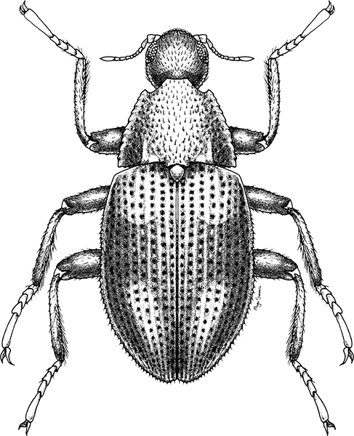
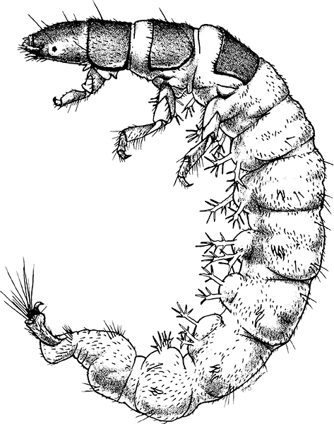
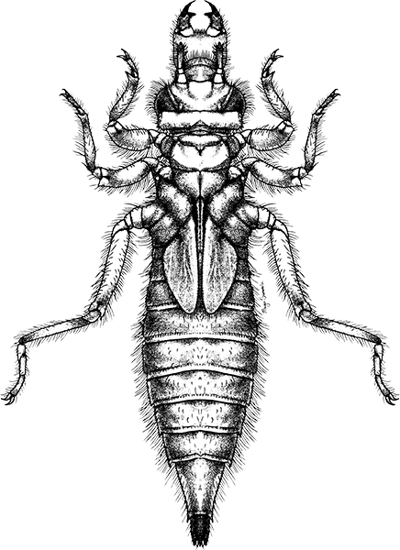
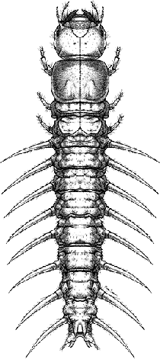
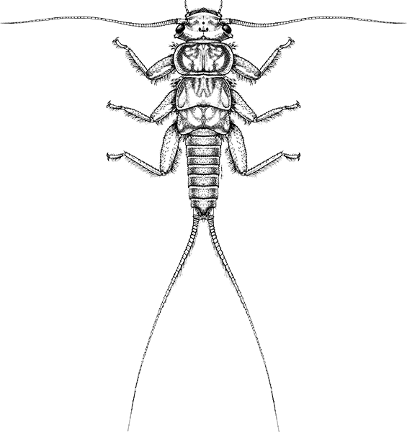
Identifying Aquatic Macroinvertebrates
[Volunteer Level]
Notes:
This presentation is intended for freshwater macroinvertebrate trainers leading experiences in identification to the Order and some Family level. It is not for general life history, strictly for ID, however, organized by sensitivity for ease of teaching.
We call this the ‘Volunteer level’ and really it is meant as a beginner’s guide to aquatic macroinvertebrate identification and follows most (not all) volunteer bio-monitoring program taxa lists.
NOTE: Trainer can delete slides that are not in your taxa list. This presentation is not exhaustive for everything you should know about identification, but is intended as a supplement to your own presentations used in trainings. Again, it is focused on identification, not life history traits (i.e. life cycle, aquatic habitats, functional feeding groups, etc.).

Slide 2
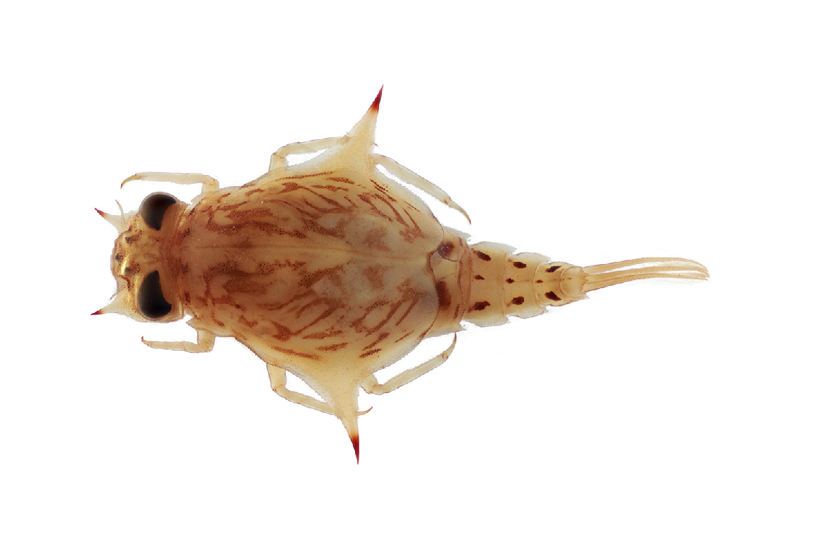
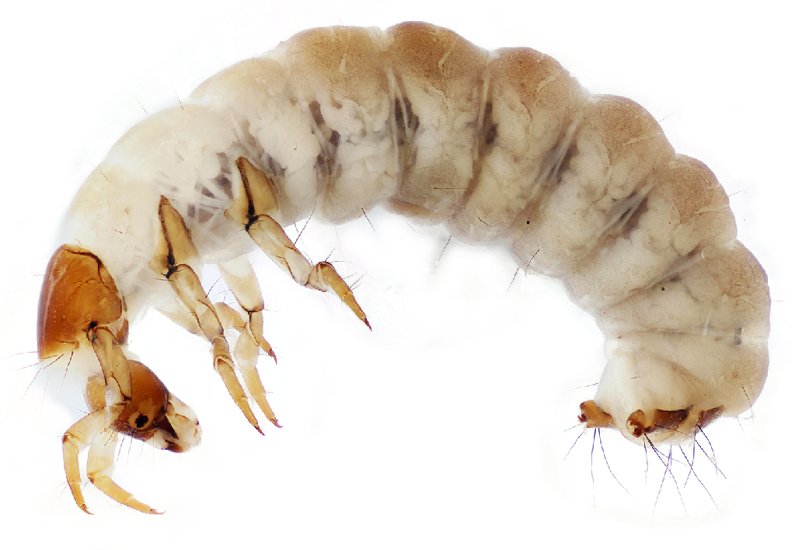
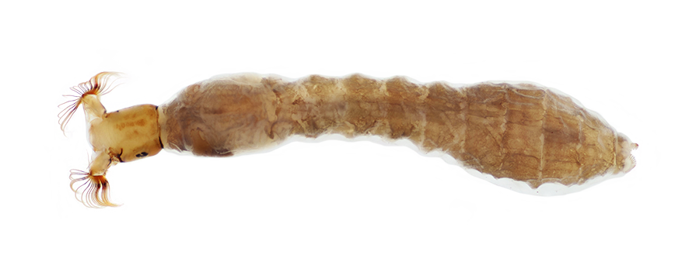
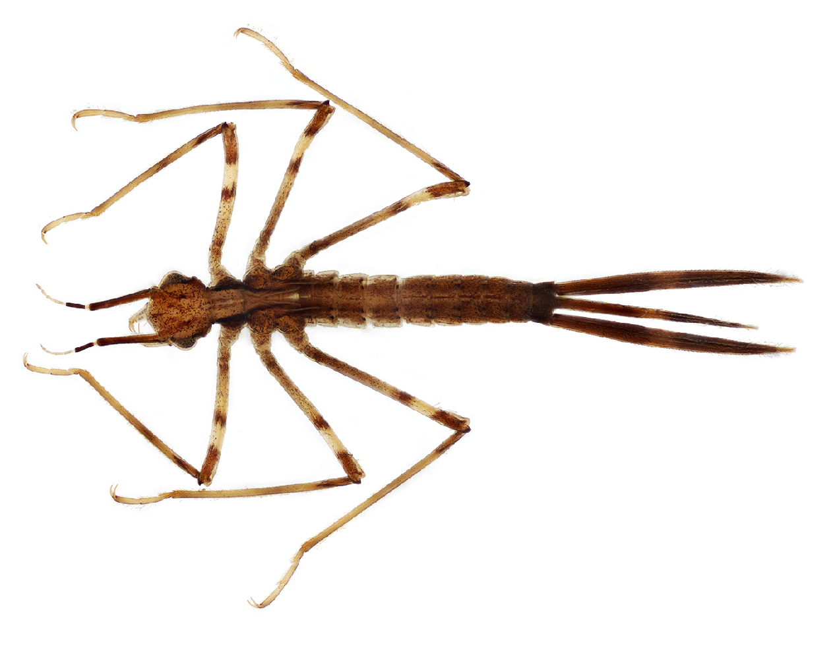
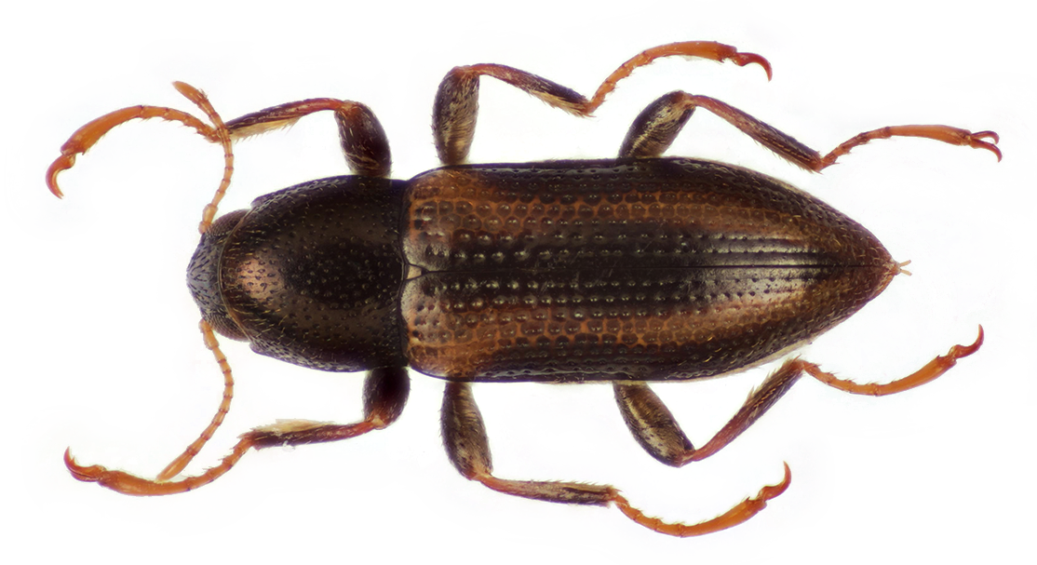
Benthic Freshwater
Macroinvertebrates
Notes:
Go through definition…

Slide 3
Benthic Freshwater
Inhabit bottom areas/substrate
Macroinvertebrates
Notes:
Go through definition…

Slide 4
Benthic Freshwater
Streams, rivers, lakes, ponds
Macroinvertebrates
Notes:
Go through definition…

Slide 5
Benthic Freshwater
Macroinvertebrates
Relatively “large” (>0.2–0.5mm)
Notes:
Go through definition…

Slide 6
Benthic Freshwater
Macroinvertebrates
Animals without vertebrae
Notes:
Go through definition…

Slide 7
Benthic Freshwater
Inhabit bottom areas/substrate
Streams, rivers, lakes, ponds
Macroinvertebrates
Relatively “large” (>0.2–0.5mm)
Animals without vertebrae
Notes:
Go through definition…

Slide 8
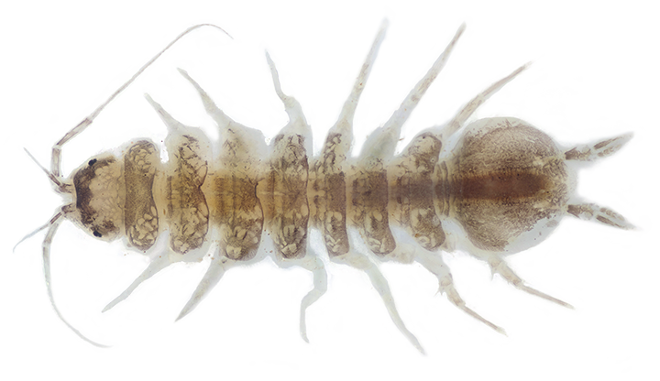
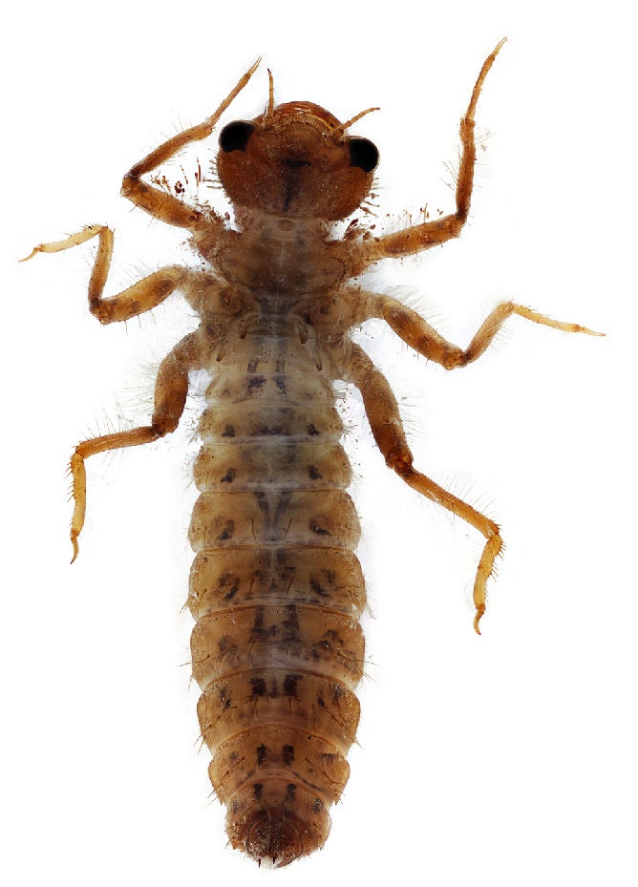
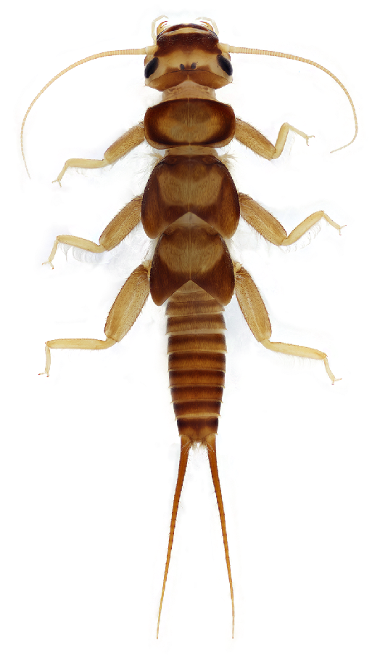
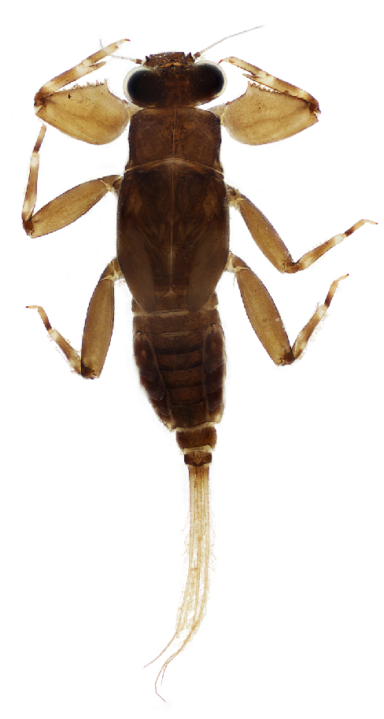
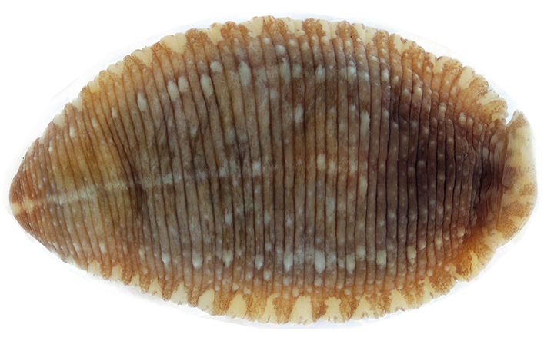
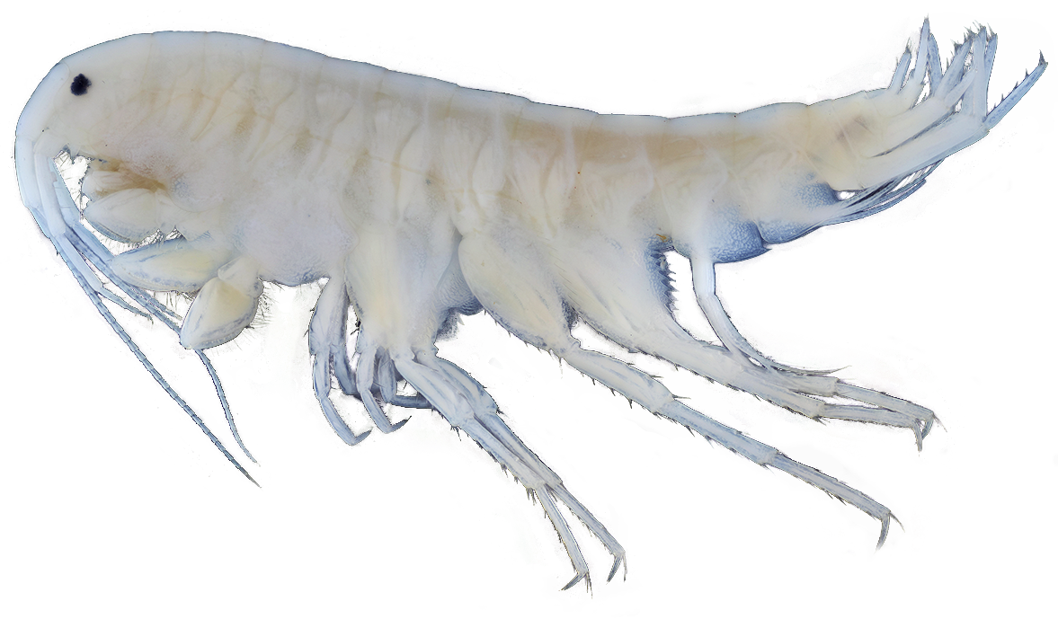
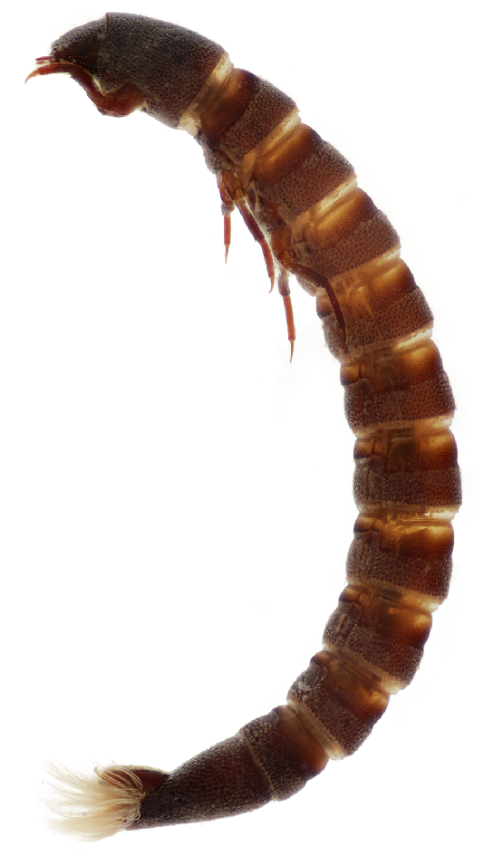
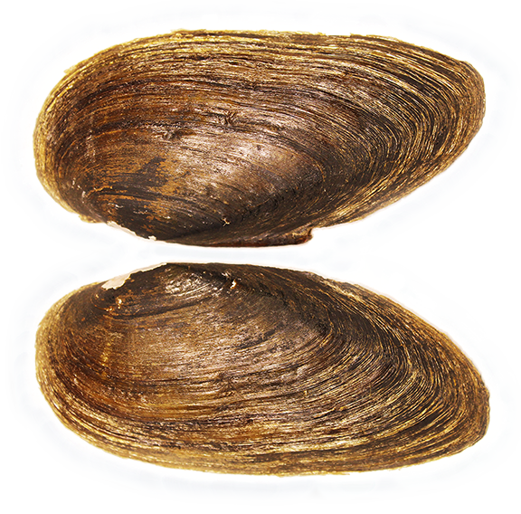
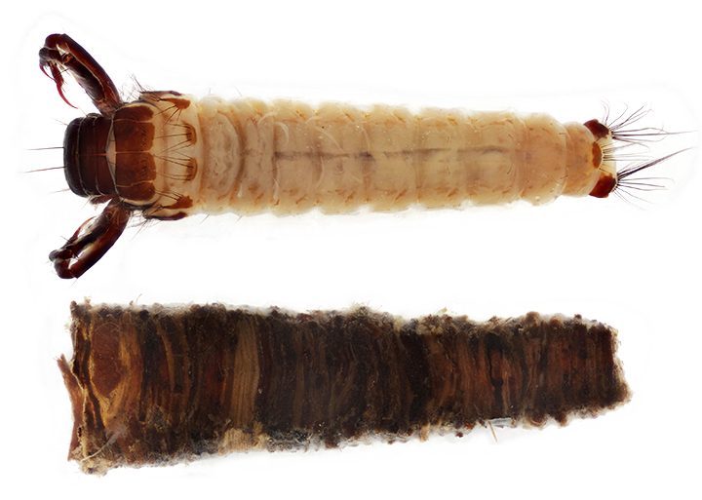
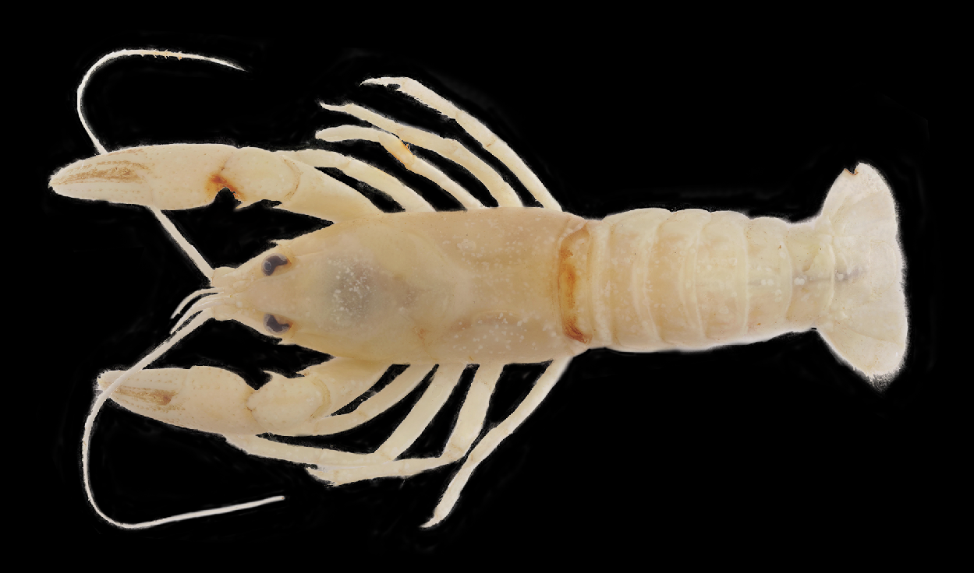
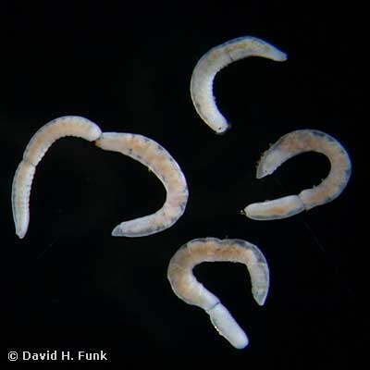
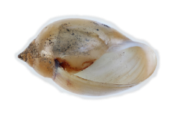
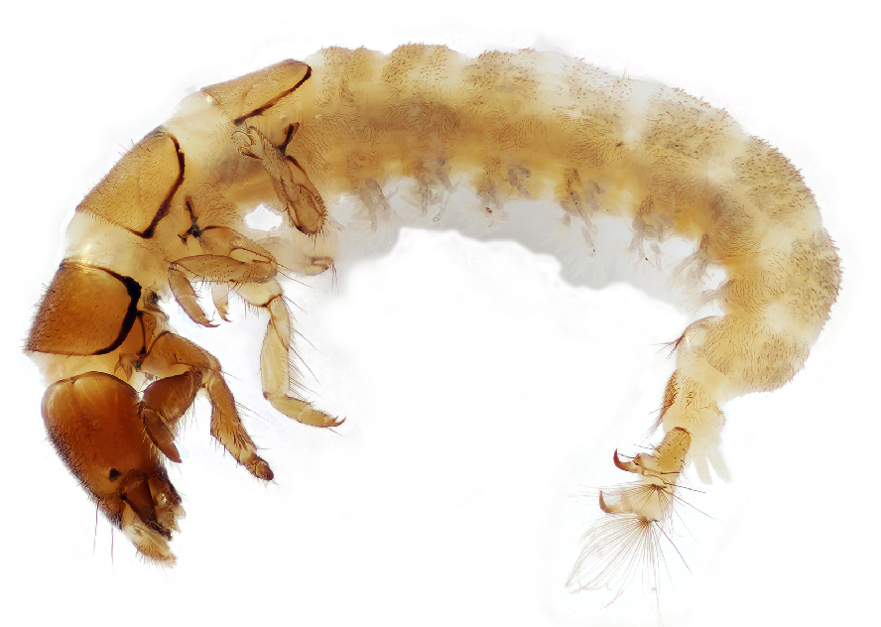
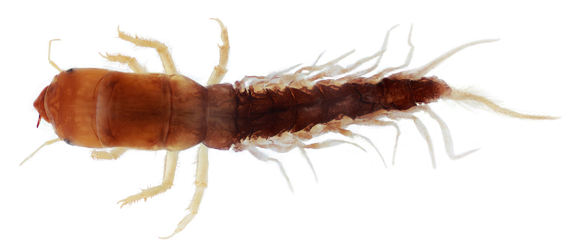
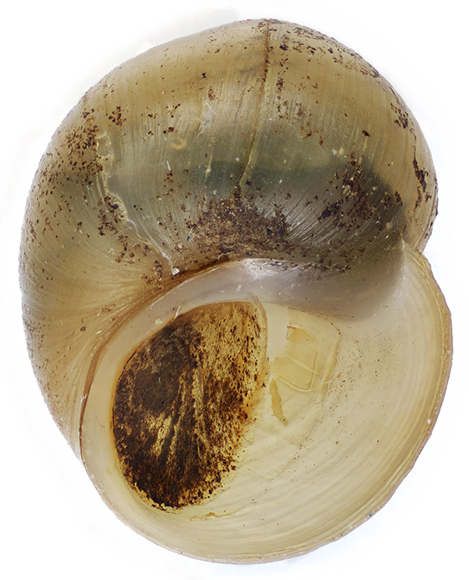
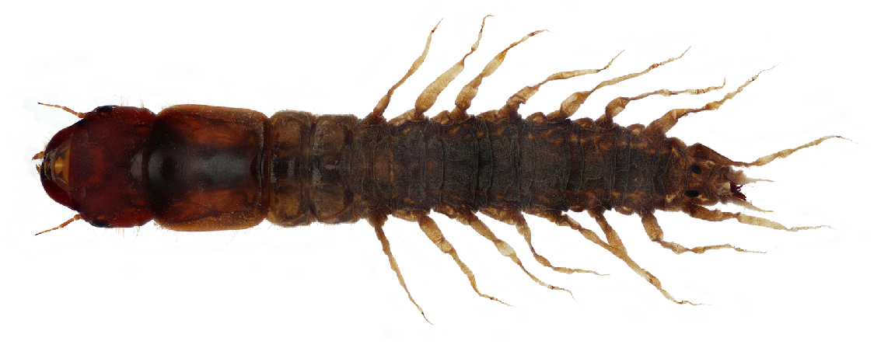
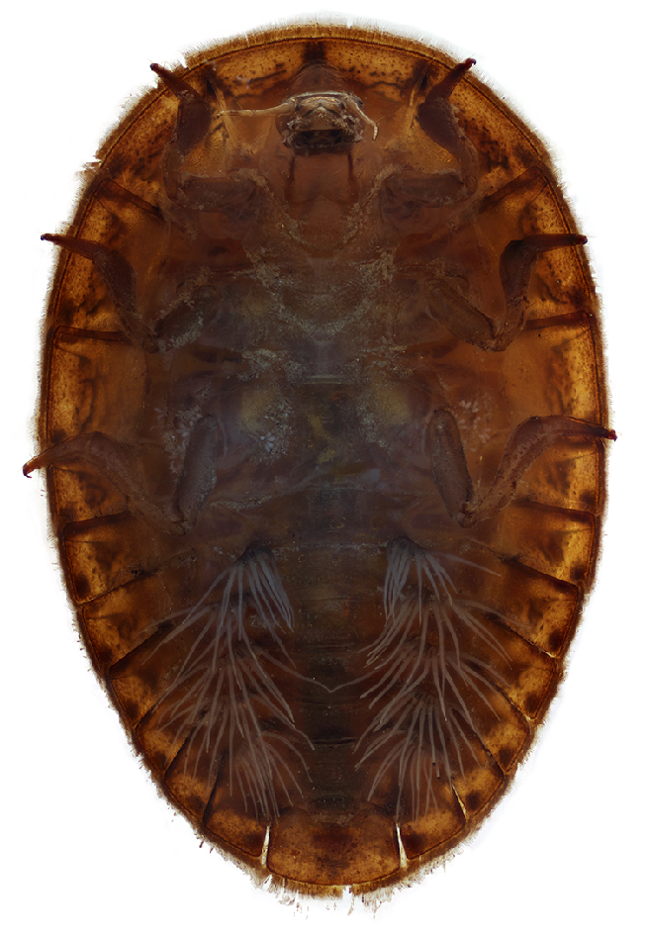
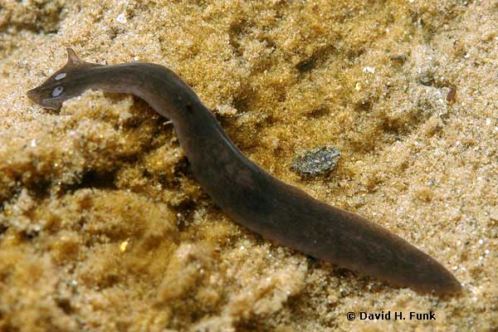
Benthic Freshwater Sensitivities
Pollution Sensitive
Somewhat Sensitive
Tolerant
Aquatic Sowbug
Midge Fly Larva
Riffle Beetle (adult)
Crane Fly Larva
Dragonfly Nymph
Stonefly Nymph
Scud
Leech
Black Fly Larva
Riffle Beetle (larva)
Mayfly Nymph
Damselfly Nymph
Caddisfly Larva (non-Hydropsychidae)
Clams & Mussels
Crayfish
Aquatic Snipe Fly Larva
Left-Handed/Lunged
Snail
Aquatic Worm
Net-spinning Caddisfly Larva
Right-handed / Gilled Snail
Dobsonfly / Fishfly / Alderfly
Water Penny Larva
Planarian
Notes:
They have been studied for nearly over a century (since 1920s) and their tolerances and intolerances to pollutants is well known. Here is a basic view of 3 sensitivity categories: Pollution Sensitive, Somewhat Sensitive, Tolerant that this presentation will follow as we go through the different taxa.
NOTE: feel free to walk through these, but in the subsequent slides, you will have these separated out and can go over them deeper at that time in the presentation.
This is a good slide to print out for your volunteers to have

Slide 9
What makes identification difficult?

Slide 10
What makes identification difficult?
Same Order
Notes:
NOTE for TRAINER: You’ll now lead into how to ID and tips for starting.
Go over with your audience the following 3 slides of what makes this group challenging to ID
1. Same orders look very different – both mayfiles – spiny crawler and armoured.

Slide 11
What makes identification difficult?
Different Order
Notes:
2. Different order look very similar – mayfly and a stonefly

Slide 12
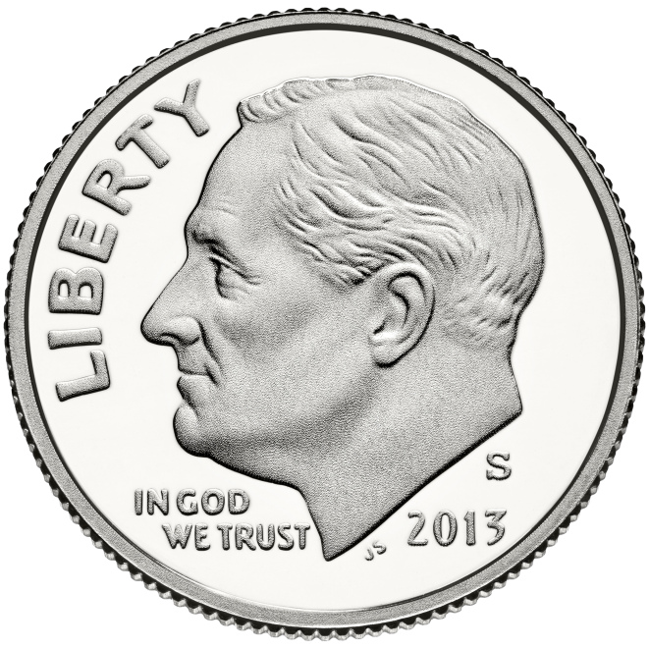
What makes identification difficult?
Specimen Size
0.5–1.5” length
0.705” diameter
Notes:
3. Some of these are very small “macro” only just visible to naked eye…

Slide 13
Tips for diving into ID
Start with characteristic features (morphology)
Pay attention to general size ranges
Go slow!
Dive into one Order at a time, and compare Orders
Know habitat: where to expect them, sensitivity levels
Watch live movement
Repetition!
Confirm IDs = Confidence
Use multiple resources
Cool facts and compelling videos!
Notes:
How does one learn? To see? Insert strategies to ID and to train
To learn macro ID: show bubble of components
OVERALL
hands-on with live macros in the field (in RED) category of the best
Confirmation of IDs is imperative for your learning
Time – take it slow and ID at your own pace learning
Use a Key, know your characteristics
Receive guidance to start
Have fun (no stress)
Repetition
Preserved specimens
Time looking closer
ONCE ID’ing
Look at characteristic features
Go slow
Repeat
Go through a key
de, have each number come out separately

Slide 14
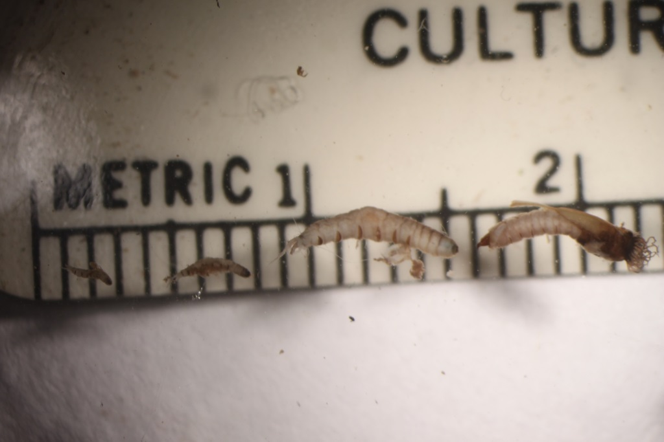
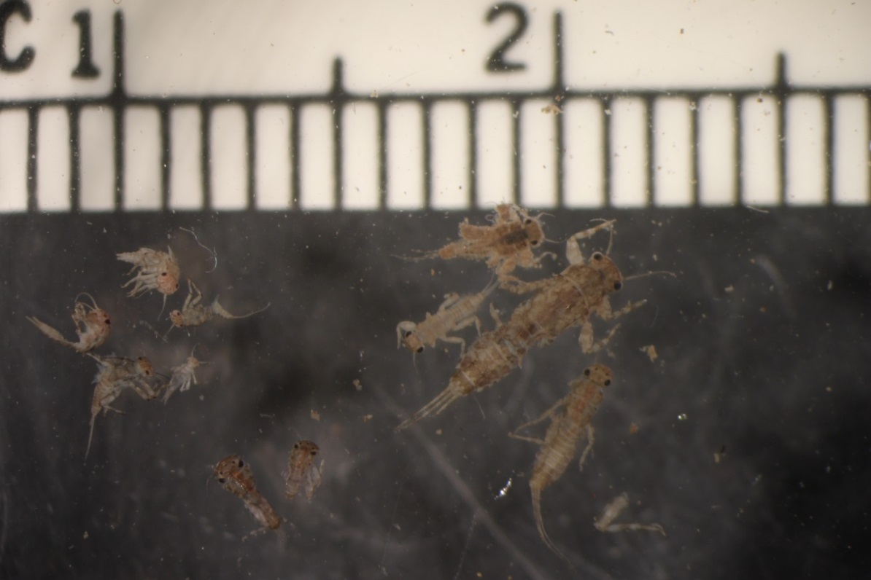
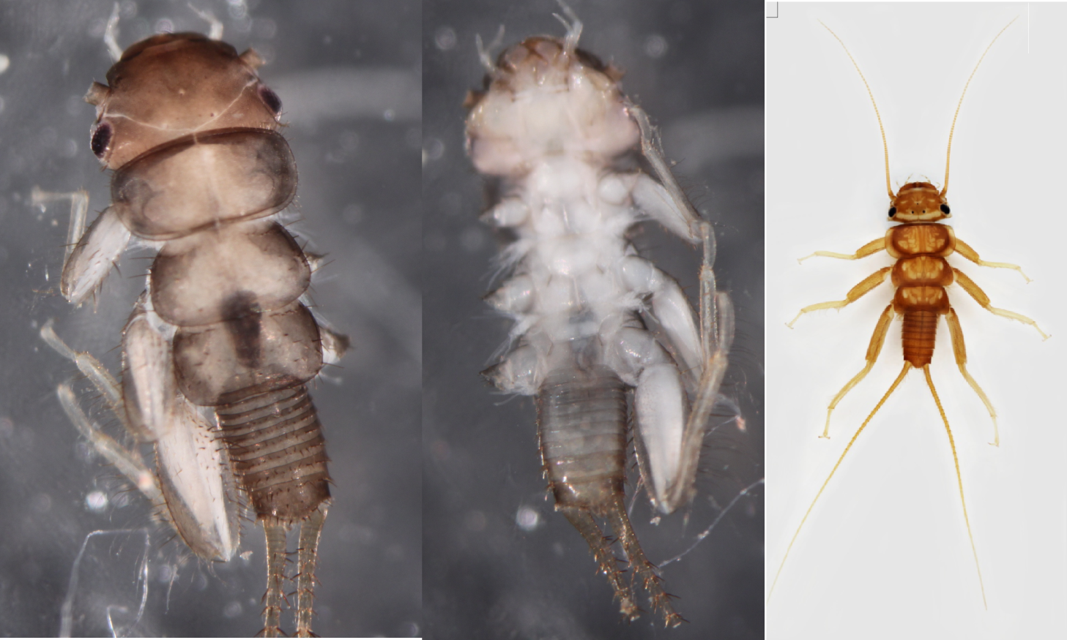
Tips for diving into ID cont’d
Instars
Sorting–‘like’ critters
Broken appendages—legs,tails
Looking closely at sample—try not to miss the tiny stuff
Notes:
How does one learn? To see? Insert strategies to ID and to train
To learn macro ID: show bubble of components
OVERALL
hands-on with live macros in the field (in RED) category of the best
Confirmation of IDs is imperative for your learning
Time – take it slow and ID at your own pace learning
Use a Key, know your characteristics
Receive guidance to start
Have fun (no stress)
Repetition
Preserved specimens
Time looking closer
ONCE ID’ing
Look at characteristic features
Go slow
Repeat
Go through a key
de, have each number come out separately

Slide 15
Tips for diving into ID
Instars
Size
Notes:
Some taxa in your samples might be different sizes.
Reasons why:
Might be different species that look similiar
Might have different cohorts (multivoltine) within the species
Might have different development by individuals ie: instar (a phase between two periods of molting in the development of an insect larva)

Slide 16
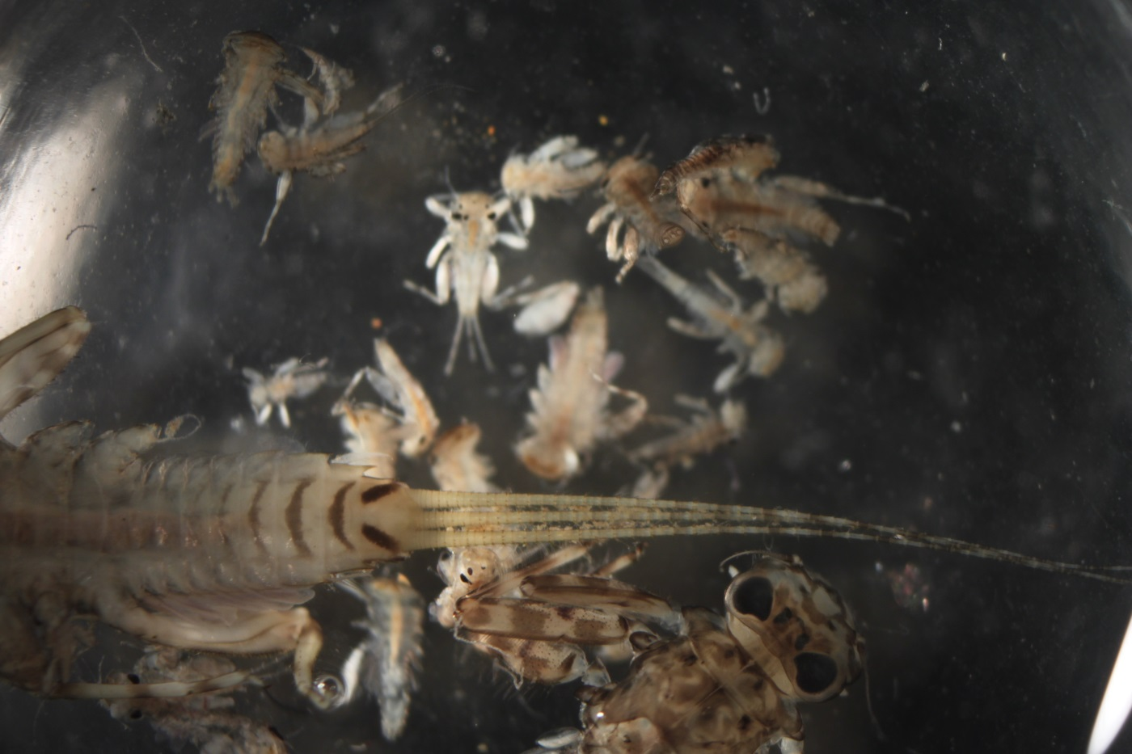
Tips for diving into ID
3. Sorting–like with like
Notes:
Sometimes it is easier to look at the insects with a broad view. Group them by likeness first before attempting to identify.
The above group of three tailed individuals (mayflies) were grouped into small groups of likeness. It is likely that the smaller groups are different families.

Slide 17
Tips for diving into ID
4. Broken appendages—legs, tails
Bilateral symmetry: the property of being divisible into symmetrical halves on either side of a unique plane
Notes:
Broken or damaged specimens can occur from various reasons. It is our hope that this does not occur and that we treat the specimens as carefully as possible to prevent damage.
Even with damaged individuals it might be possible to discern characteristics by knowing that the insects have bilateral symmetry. (Bilateral Symmetry is the property of being divisible into symmetrical halves on either side of a unique plane.)

Slide 18
Tips for diving into ID
4. Broken appendages—legs, tails
Bilateral symmetry is helpful when looking at damaged specimens.
Notes:
Broken or damaged specimens can occur from various reasons. It is our hope that this does not occur and that we treat the specimens as carefully as possible to prevent damage.
Even with damaged individuals it might be possible to discern characteristics by knowing that the insects have bilateral symmetry. (Bilateral Symmetry is the property of being divisible into symmetrical halves on either side of a unique plane.)
The above damaged specimen can still be ided because of bilateral symmetry. We know that it has missing legs because the other side has legs. The antenna are difficult to see because both are broken off close to the head above the eyes.
When counting, only count individuals with heads to avoid double counting specimens.

Slide 19
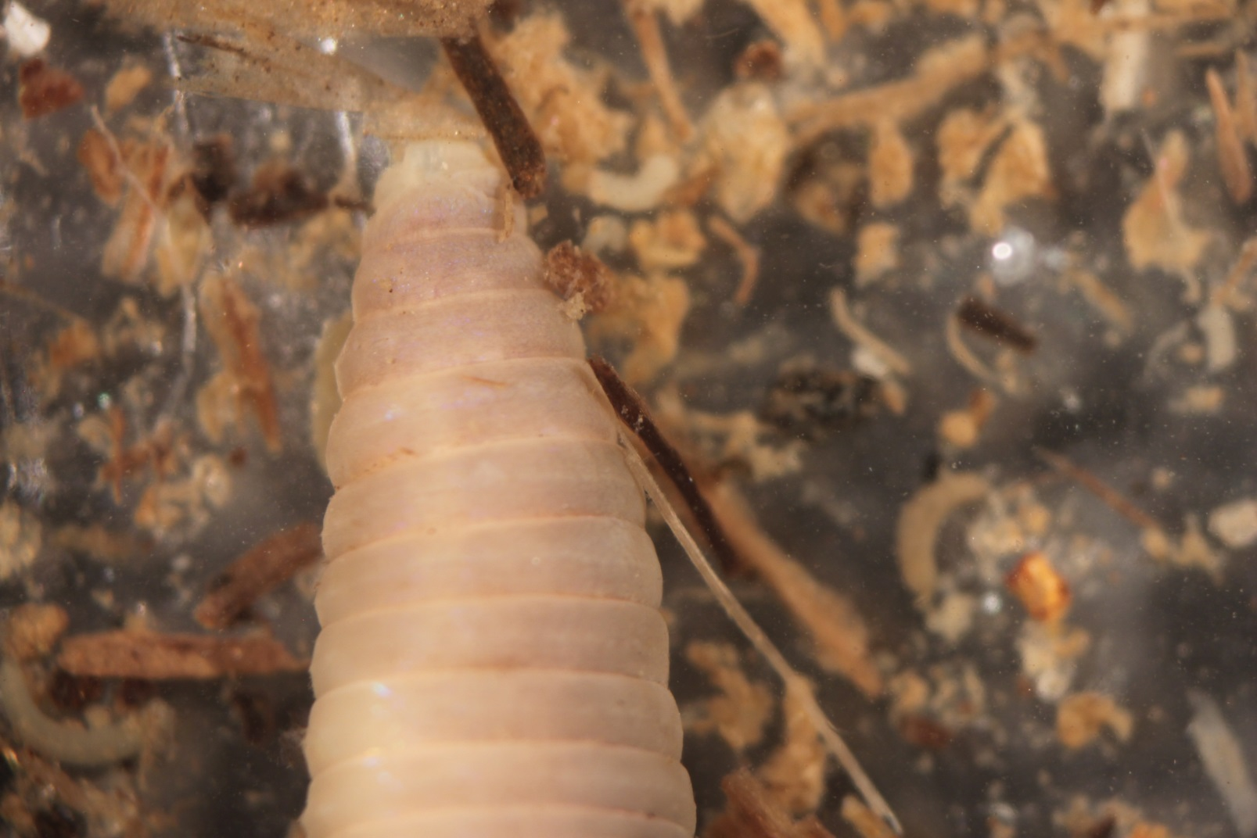
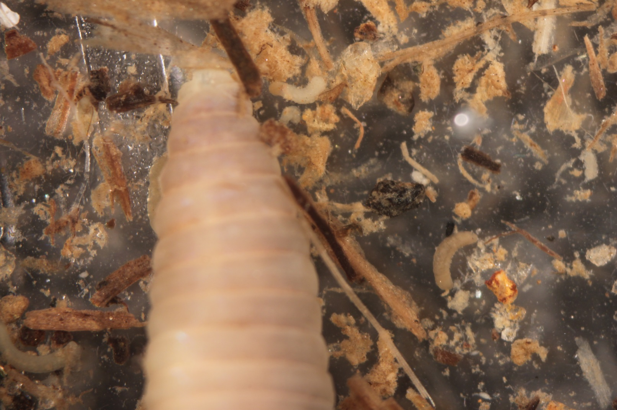
Tips for diving into ID
5. Looking closely at the sample-try not to miss the tiny stuff
are easily looked over
Looks like only the one worm body but actually several small ones are present too.
Notes:
Midge larvae, black fly larvae, beetle larvae as well as early instars are easily looked over! Make sure to comb through your samples.

Slide 20
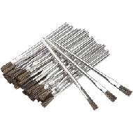
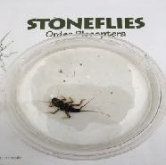
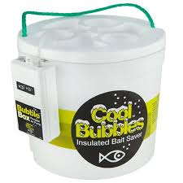
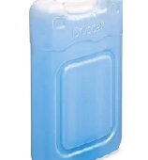
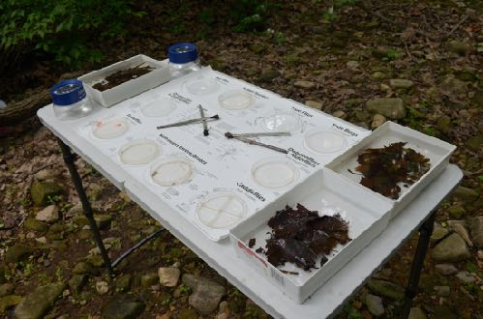
Working with a live insect
Tools to use:
Small paint brush and/or plastic spoon
Forceps are ok, try not to smoosh the critter!
White sorting pan, or petri dish
Work from a table
Hand-lens and flashlight
Reminders:
The macroinvertebrate must be submerged in water
Best to keep them in the shade, cooler temperatures
Minimize handling time
Insects need oxygen!
Notes:
When working with live macroinvertebrates there are many tips to making this a less stressful experience for both you and the organism!
Tools to use: Small paint brush and/or plastic spoon, white sorting pan, petri dish, or even ice cube tray (white so you can see them better)
Best to work from a stable foundation (table)
Reminders: all to reduce stress and enable them to be returned live to the collection site
The macroinvertebrate must always be submerged in water! Best is the stream/river water they came from.
Best to keep them in the shade, cooler temperatures (this reduces their stress and keeps more oxygen in the water)- in your collection bucket you can put ice packs in to keep it cool
Minimize handling time
They need oxygen! Add a bubbler to your bucket to supply oxygen (see image of Styrofoam cooler that comes with bubbler)

Slide 21
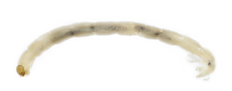
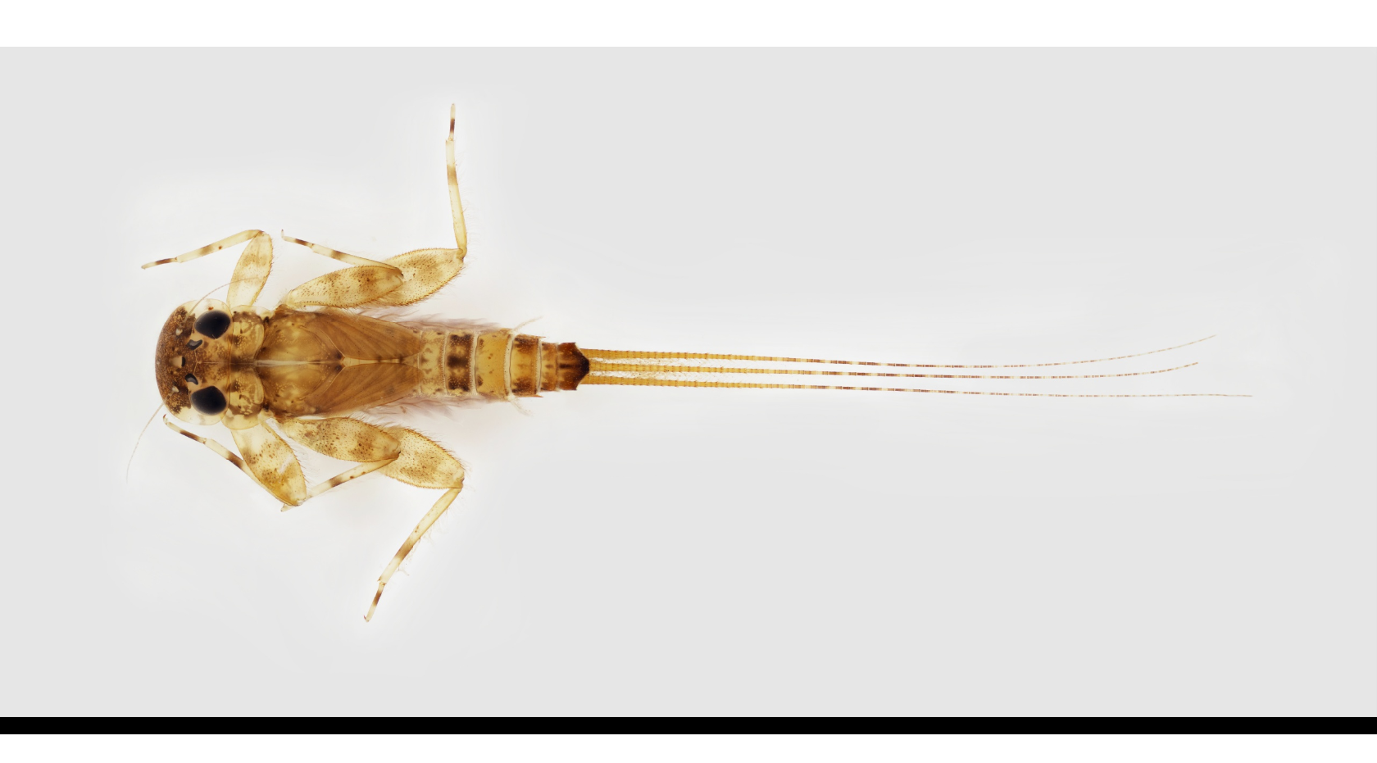
The Insect
Lateral
Prolegs
Head
Thorax
Abdomen
Gills (abdomen -or- thorax)
Wing Pads
Tail Filaments
Antenna
Jointed Legs (6)
Lateral
Anterior
Posterior
Notes:
The ability to identify the different taxa relies heavily on knowing their forms and characteristics that gives them their classification.
NOTE:
start by engaging learnings in morphology and terms that may be new. Give your learners a copy of this form and have them take notes as you go along.
point out that there are ‘instars’ so you may not see certain characters (i.e. wing pads). Insects (Arthropods) molt or shed their exoskeleton at different developmental stages.
We will mostly be identifying macroinvertebrates in their juvenile stage of metamorphosis (larva or nymph) not the pupae; sometimes adults (i.e.beetles, snails, mussels, etc.)
SIZE is very important, so note sizes (usually found in keys) to distinguish between taxa
Here we show insect morphology: Head, Thorax, Abdomen. A majority (approx.70%) of what you find in the stream will be of the Insecta Class.
You can ask the audience what they might notice on each of these three major segments (and the adaption) that would be good to look for such as antenna (head), and on the thorax: number of jointed legs (note: sometimes these break off; sometimes there are no legs, and sometimes there are prolegs which don’t have joints or bend), wing pads (Note: these aren’t always present- depends on the instar/phase of the insect as to if this is shown or not), placement of the gills (here shown on the abdomen, but can be anywhere on the body and come in a variety of forms; sometimes no gills are present), number of tails (note: sometimes these break off).

Slide 22
Notes:
Macroinvertebrates.org has innovative ways to learn morphological traits:
Using the key, you can click on blue triangle w/+ sign to learn about a trait, what it looks like, where it is located.
And…next slide

Slide 23
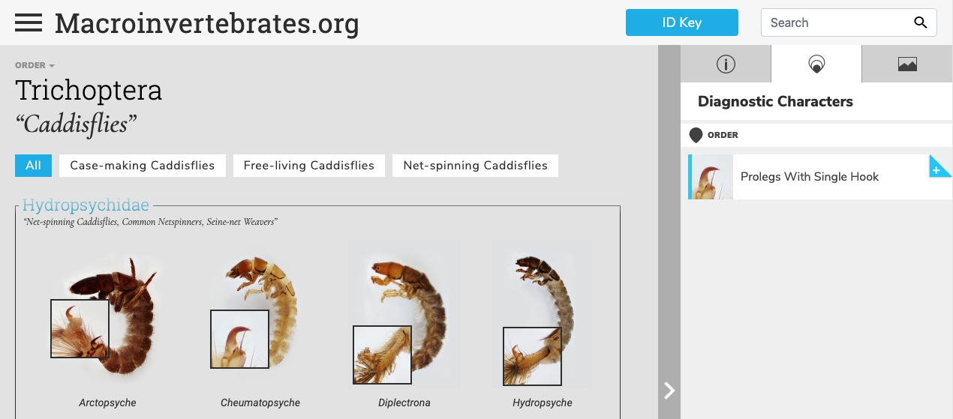
Notes:
On the Order or Family pages, click the ‘diagnostic characters’ page and you will also be pointed to these features!
(Clicking on the blue plus sign next to a feature will open a gallery of all features within an order!)

Slide 24
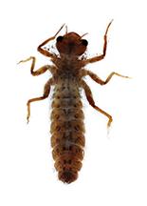
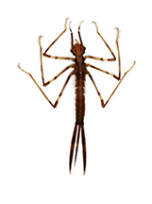
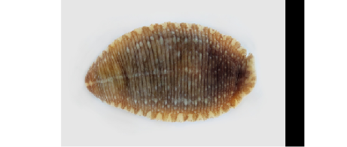
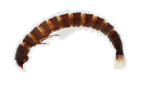
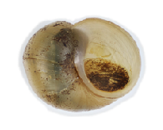
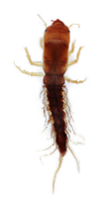
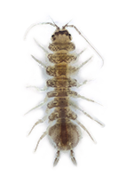
Commonly Misidentified Taxa
Stoneflies
Mayflies
Dragonflies
Damselflies
Planaria
Leeches
Aquatic Worms
Crane
Flies
Midge
Flies
Black
Flies
Watersnipe
Flies
Riffle Beetles
Caddisflies
Midge Flies
Gilled Snail
Lunged Snail
Alderflies
Fishflies /Dobsonflies
Scuds
Sowbugs
Notes:
Now let’s dive into each of the taxa, but first, note that many look alike! To help you, here is a chart with the commonly misidentified groups of taxa.
NOTE: This could be a nice slide to print out to give as a guide for learners.

Slide 25
Group 1 Taxa: Pollution Sensitive!
Require High Levels of Dissolved Oxygen
Found in Good Quality Water
Mayfly Nymph
Stonefly Nymph
Riffle Beetle (adult/larva)
Water Penny Larva
Caddisfly Larva (non-Hydropsychidae)
Watersnipe Fly Larva
Right-handed / Gilled Snail
Notes:
Now we’ll go into the 3 major sensitivity groups found on the Eastern United States.
Group 1 Taxa are the pollution sensitive group (or most sensitive out of the 3 groups).
These taxa require high levels of dissolved oxygen and indicate good water quality
These include:
Mayfly nymphs
Stonefly nymphs
Riffle Beetle ADULTS & LARVA (Both life stages)
Water Penny Larva
All caddisflies (except the net-spinning caddisflies which are in Group 2)
Aquatic Snipe Fly Larva
Right-Handed/Gilled Snails
So let’s go over each one of these in more depth and their characteristics!

Slide 26
Stonefly Nymph | Plecoptera
9 families, 780 species
½ to 1½ inches in length (not including tails)
Yellow to brown in color
Stonefly nymphs always have 2 tails, prominent antennae, and 2 claws at the end of each leg
Two sets of wing pads (seen better after molting)
Some with branched gills between legs on underside of body
Prefer cold, swift-moving streams.
Streamlined, flattened bodies enable them to move about rocky streambeds in rapid currents
xi
Similar to Mayfly
Group 1: Pollution Sensitive
Notes:
LIFE HISTORY:
Stonefly nymphs prefer cold, fast-flowing, and highly oxygenated lotic habitats in springs, streams, and rivers, where they often live under leaf packs and the stones that are their namesake. Most naiad species are herbivorous, often feeding on submerged leaves and benthic algae as shredders and scrapers, but other species are predator-engulfers of fellow macroinvertebrates. Pteronarcys can also grow a lot bigger than 1.5" (excluding tails)
ID:
Commonly confused with mayflies (Order Ephemeroptera), stoneflies can be distinguished by two tarsal claws and fingerlike or hair-like gills on the thorax and, unless they become lost or broken, exhibit two “tails” or cerci. Although gills may also be present on the head, bases of legs, and/or the abdomen, stoneflies never exhibit the plate-like abdominal gills or the single tarsal claw found in all mayflies (which they are often mistaken for).

Slide 27
Notes:
More images from the website to show two tails and two claws

Slide 28
Mayfly Nymph | Ephemeroptera
Up to ¾ inch in length (not including tails)
Slender antennae, gills on abdomen, one tarsal claw
May be minnow-like with a vertically-oriented head and three tails (pictured) —or— may be more flattened with a horizontally-oriented head and two tails
Two rows of long hairs present on inside of front legs, used for filtering food particles from the water (this is for family IDs)
Similar to Stonefly
Group 1: Pollution Sensitive
Notes:
LIFE HISTORY:
With “Ephemeroptera” derived from the Greek word for “lasting a day,” this order of insects earns its name from a notoriously short-lived adult lifespan, which can last less than 24 hours. However, young mayfly nymphs may feed and grow in streams, rivers, lakes, and ponds for up to two years.
As important links in the freshwater food web, young mayflies are often voracious herbivores, detritivores, or even carnivores, in addition to being preferred food sources for many freshwater carnivores.
ID
They can be distinguished by two to three tails (two cerci always sometimes accompanied by one median caudal filament) at the end of the abdomen, one tarsal claw on each leg, and feathery or plate-like abdominal gills.
Often confused with stoneflies (see next slide for comparison)

Slide 29
Notes:
More images from the website to show ‘usually 3 tails,’ tails, abdominal gills, and a single claw

Slide 30
Stoneflies vs. Mayflies
Group 1: Pollution Sensitive
Notes:
Speaking Points
Make sure to point out the Gills on the mayfly (abdomen)
Most mayflies have 3 tails, but some have 2 and gills are more reliable for telling them apart
2 tarsal claws (stonefly) vs. 1 on mayfly

Slide 31
Water Penny Larva | Coleoptera
¼ inch in length
Distinctive flat, disk-like body
Head and legs not visible from above
6 legs and most have branched gills on underside
Prefer cold, fast-moving water
Smooth, flattened bodies enable them to resist the pull of the current.
Usually found on smooth rocks where they graze on attached algae
Coleoptera: Psephenidae
Group 1: Pollution Sensitive
Notes:
ID
WP are as tiny as your pinky fingernail
Flat body, looking very similar to a horseshoe crab
The larvae are fully aquatic. They are very distinctive, flat, shield-shaped larvae, almost trilobite-like in appearance, with the legs only visible from the ventral side. They are almost always found stuck (suction cup-like) to the sides and tops of rocks, where they feed by scraping periphyton and other food off of the substrate.

Slide 32
Gilled Snail | Gastropoda
Shell usually opens on the right
Shell opening covered by a thin plate (operculum)
When monitoring, do not count empty shells!
Similar to Lunged Snail
Group 1: Pollution Sensitive
Notes:
ID
Note: there are two snail categories to look for: This right-handed or Gilled snail, and then the left-handed or lunged snail (in the tolerant sensitivity group).
This right-handed snail has an opening ‘to the right’- how can you tell? Simply point its tip (hard to see here) to the sky and if you can put your right hand into the opening, it’s the righ-handed snail
This snail, unlike the left-handed, has gills and needs more oxygen. Left-handed/lunged snails are not limited by oxygen and can move above water if oxygen levels are low.

Slide 33
Caddisfly Larva | Trichoptera
*(excluding Hydropsychidae)
Up to 1.5 inch in length
Three pairs of legs
Two claws at posterior end
Antennae reduced and inconspicuous
Curls up slightly (not as tight as the common net-spinning caddisfly)
Some build distinctive cases made of sticks, rocks, sand, plant material, other debris
Some may not have a case when found!
Similar to Riffle Beetle Larva, Net-spinning Caddisfly, Midge Fly
Group 1: Pollution Sensitive
Notes:
LIFE HISTORY:for every family but the Hydropsychidae
Caddisfly larvae (2 mm – 40 mm) inhabit a broad scope of freshwater habitats, including streams, rivers, lakes, and ponds, before undergoing complete metamorphosis (holometabolous metamorphosis) into winged adults.
Many larvae are known for their ability to construct cases from sticky homespun silk and sand grains, pebbles, or plant matter, but other species may be free-living or form silken nets to capture particles from the water column.
In addition to being important food sources in aquatic food webs, caddisfly species can be found across all feeding guilds for macroinvertebrates, including shredders, scrapers, and collector-filterers.
ID
Larvae can be distinguished by six well-developed legs on a worm-like cylindrical body and a pair of claw-bearing prolegs at the end of the abdomen.
NOTE: this is one of two categories of Caddisflies typically identified in volunteer monitoring programs. Here we have all the Caddisfly families except the Net-Spinning Caddisfly group (Family: Hydropsychidae)

Slide 34
Notes:
More images from the website to show prolegs with a single hook (hard to see on a live individual); some have portable cases; some are free- living

Slide 35
Riffle Beetle | Coleoptera
(Elmidae)
Includes adults and larvae
Measure approximately 1/16 to ¼ inch in length
Adult
Body small, usually ovular
Legs are long
Antennae usually slender
Do not swim on surface; found under water
Larvae
Usually no lateral abdominal gills. If gills present, then 4 hooks clustered on segment 10
Thoracic legs, each usually with 4 or 5 segments, and 1 or 2 claws
Similar to Caddisfly, Midge Fly
Group 1: Pollution Sensitive
Notes:
LIFE HISTORY:
They are known as riffle beetles, due to their common occurrence in habitats with fast-flowing water and high oxygen levels.
The larvae get their oxygen directly from gills that can be retracted into the end of the abdomen.
Adults have an effective plastron and usually do not need to surface for air.
Elmid larvae are unusual in that they have up to 8 instars, whereas most beetle larvae molt only 3 times.
Rare family who remain aquatic in both larval and adult forms
Elmids can be absolutely jet black as larvae and adults for some genera; sometimes it happens late in their final instar, and rarely they are just black for all stages.
ID
ADULTS: brown in color; tiny as a pin head; have hardened elytra (wings), with two claws
LARVAE: Dark brown, typically tinier than caddisfly larva, hard-bodied, cylindrical and slightly C-shaped; long legs compared to body size; two claws on the ends of legs

Slide 36
Riffle Beetles vs. Caddisflies Vs. Other Beetle Larvae
Group 1: Pollution Sensitive
Notes:
Speaking Points
Use pictures to demonstrate differences between riffle beetle larvae and caddis flies
Riffle beetle larva are usually ‘crunchy’ (hard bodies) vs caddisflies and other beetles which are ‘squishy’ (or soft-bodied)
Note how riffle beetles don’t have tufts on abdomen like Common net spinners (not pictured)
Note how riffle beetles have a dark, armored appearance along their entire body, whereas caddis flies do not.

Slide 37
Riffle Beetles vs. Caddisflies Vs. Other Beetle Larvae
Body “soft” (fleshy) along all segments
Body “harden” (sclerites) along all segments
Exposed pair of claws
Covering over gills and pair of claws
Group 1: Pollution Sensitive
Notes:
Speaking Points
Use pictures to demonstrate differences between riffle beetle larvae and caddis flies
Riffle beetle larva are usually ‘crunchy’ (hard bodies) vs caddisflies and other beetles which are ‘squishy’ (or soft-bodied)
Note how riffle beetles don’t have tufts on abdomen like Common net spinners (not pictured)
Note how riffle beetles have a dark, armored appearance along their entire body, whereas caddis flies do not.

Slide 38
Watersnipe Fly Larva | Diptera
Measure ¼ -1 inches in length
Mostly cylindrical, with the front tapering to a cone-shaped point
Pale brown to green color
Larva have a number of mostly paired caterpillar-like prolegs
Two stout, pointed tails with feathery hairs at back end
Front of body tapered to a point
Paired, caterpillar-like prolegs
(Athericidae)
Two pointed tails with feathery hairs at back end
Similar to Crane Fly, Midge Fly and other ‘True Flies’
Group 1: Pollution Sensitive
Notes:
ID:
The head is visible but reduced and partly retracted in the thorax; the mouth hooks (mandibles) move up and down parallel to one another; the body is cylindrical; the abdomen has two pairs of long pointed tubercles laterally and dorsolaterally, eight pairs of ventral prolegs with tiny apical hooks, and a pair of long hairy tubercles posteriorly.
Look similar to crane flies (which have no prolegs) and midges (which are much smaller), and another kind of Dipteran in the Family Empididae (dance flies)

Slide 39
Group 2 Taxa: Somewhat Sensitive!
Require Moderate Levels of Dissolved Oxygen
Found in Good or Fair Quality Water
Crane Fly Larva
Clams & Mussels
Dragonfly Nymph
Damselfly
Nymph
Aquatic Sowbug
Caddisfly Larva (Net-spinning ones)
Dobsonfly/Fishfly/
Alderfly
Crayfish
Scud
Notes:
Group 2 Taxa are somewhat sensitive to pollution.
These taxa require moderate levels of dissolved oxygen and indicate good/fair water quality
This group includes the following taxa:
Dragonfly Nymphs and Damselfy Nymphs
Crane Fly Larva
Clams and Mussels
Dobsonflies/Fishflies/Alderflies
One particular group of caddisflies called the ‘Net-Spinning’ caddisflies
And the Crustaceans: Crayfish, Scuds, Aquatic Sowbugs
So let’s go over each one of these in more depth and their characteristics!

Slide 40
Crane Fly Larva | Diptera
(Tipulidae)
Head is usually pulled back into the front of the body
Measure 1/3-2 inches in length
Plump caterpillar-like segmented body
Milky green to brown color
Finger-like projections (gills) at back end of body
Similar to Midge Fly, Black Fly, Snipe Fly, Worms
Group 2: Somewhat Sensitive
Notes:
LIFE HISTORY:
Until recently, Tipulidae included all species of "crane flies." As now more strictly defined, this widespread family includes at least 53 species in North America.
Larvae of some species are terrestrial, but aquatic larvae inhabit quiet areas of streams and shores of lakes, burrowing in the soil, often among roots, shredding living and dead plant material. Some do however, live in really fast riffles if there is leaf litter trapped there (they are wrapped up like little tacos!). They love to eat leaves.
ID:
Body is cylindrical and typically soft with segments (sometimes translucent)
Head is withdrawn and not visible
Posterior ends contains short, fleshy lobes
Can be confused with midges (although they are much smaller), black fly (also much smaller) and snipe-flies (which have a series of prolegs)

Slide 41
Watersnipe vs. Crane Flies vs. Dance Flies
Group 2: Somewhat Sensitive
Notes:
Speaking Points
Note the differences in posterior appendages in watersnipe and craneflies
Water/Aquatic snipe flies also have prolegs paired at abdomen

Slide 42
Watersnipe vs. Crane Flies vs. Dance Flies
Head exposed
Head is usually pulled back into the front of the body
Front of body tapered to a point
Paired, caterpillar-like prolegs
Hook-bearing
prolegs
Two pointed tails with feathery hairs at back end
Finger-like projections (gills) at back end of body
1-4 Rounded lobes on end of abdomen
Group 2: Somewhat Sensitive
Notes:
Speaking Points
Note the differences in posterior appendages in watersnipe, craneflies, and another Dipteran, the Dance Flies (empididae)
Water/Aquatic snipe flies and dance flies also have prolegs paired at abdomen

Slide 43
Clams & Mussels
Fleshy body enclosed between two clamped shells
If alive, shells cannot be pried apart
When monitoring, do not count empty shells
Can be confused with seed pods
Group 2: Somewhat Sensitive
Notes:
ID:
For both, two shells connected by a strong hinge
No distinct head
MUSSELS:
Order of mussels (Unionida: class Bivalvia) having an anterior pseudocardinal tooth and a posterior lateral tooth present on its valves.
Difference between two:
Clams typically more oval; 1 external hinge
Mussels typically more elongate; 2 external hinges

Slide 44
Dragonfly Larva | Odonata
(Anisoptera)
Large jaw covers the underside of head
Large eyes
½ - 2 inches in length
Two pairs of wing pads
Large round or oval abdomen
Abdomen terminates in three small pointed structures
Prefers cool, still water
Often found among vegetation and leaf packs or burrowed in sediment
Stocky body without tails
Similar to Mayfly, Stonefly, Damselfly
Group 2: Somewhat Sensitive
Notes:
LIFE HISTORY:
Commonly found in standing waters (lentic systems) or slow-moving running waters (lotic systems), these fierce underwater predators remain one of the most fundamentally aquatic insect orders, with all known North American nymphs spending their young lives underwater.
The Odonata can be divided into 2 suborders: the Anisoptera (the dragonflies) and the Zygoptera (the damselflies).
Fun Note: There are a handful of terrestrial dragonfly larvae in French Polynesia and Hawaii
ID:
Nymphs are distinguished by their large eyes, wing pads on the thorax, and an elbow-like “lower lip” or labium, which can project from the head to strike/seize prey or tuck neatly under the head when not in use.
Dragonflies are known for their stout bodies, heads narrower than the thorax and abdomen, and three short, wedge-shaped structures at the end of the abdomen.
Similar looking to damselflies, stoneflies and mayflies- big distinguishing feature is dragonflies have no tails!

Slide 45
Damselfly Larva | Odonata
Large jaw covers the underside of head
Large eyes
½ - 1 inch in length
Abdomen usually more narrow and slender than dragonflies
(Zygoptera)
Three oar-shaped tails (actually gills)
Similar to Mayfly, Stonefly, Dragonfly
Group 2: Somewhat Sensitive
Notes:
LIFE HISTORY:
Zygoptera (the damselflies).
ID:
Nymphs are distinguished by their large eyes, wing pads on the thorax, and an elbow-like “lower lip” or labium, which can project from the head to strike/seize prey or tuck neatly under the head when not in use.
Damselflies, exhibit slender bodies (vs. larger bodies of dragonflies), heads wider than the thorax and abdomen, and three long, leaf-like caudal lamellae at the end of the abdomen that can facilitate gas exchange.
Similar looking to dragonflies, stoneflies and mayflies- big distinguishing feature is the tail of the damselfly (3 wide tails)

Slide 46
Notes:
More images from the website to show labial mask; abdomen with 3 gills (damselfly) or without tails (dragonfly), two pairs of wing pads

Slide 47
Dragonfly vs. Damselfly
Group 2: Somewhat Sensitive
Notes:
Speaking Points
Paddle shaped tails on damsel (gills)
Dragonflies tend to be stout looking, while damsels are usually more delicate looking (just like adult forms)

Slide 48
Dragonfly vs. Damselfly
Three oar-shaped tails (actually gills), may break off,
Stocky body without tails, ends with points
Group 2: Somewhat Sensitive
Notes:
Speaking Points
Paddle shaped tails on damsel (gills)
Dragonflies tend to be stout looking, while damsels are usually more delicate looking (just like adult forms)
Dragonfly heads tend to be narrower than the body vs damselfly heads are wider than body

Slide 49
Netspinning Caddisfly | Trichoptera
(Hydropsychidae)
Dorsal plates (sclerites) on all three thoracic segments
Body is caterpillar-like with three pairs of legs
Body is strongly curved
Three dark plates on the dorsal side of the thorax
Gills on the underside of the abdomen
Setal Fan on prolegs (each proleg with a single hook)
Branched gills along underside of body
Bristle-like tufts on abdominal end
Similar to Riffle Beetle Larva, Case-making Caddisfly
Group 2: Somewhat Sensitive
Notes:
LIFE HISTORY:
Larvae build stationary retreats of silk, detritus and rock fragments. A part of the entrance of a retreat has a silken filter net protruding into the current to strain food from the water. This is how they earned the common name, “net spinners”. The mesh size of the filter net varies among hydropsychid species, corresponding with the current speed of their optimal habitat and the size of the food particles on which they specialize.
They spend most of their life hiding in their retreats, waiting for food to get caught in their nets, mostly tiny bits of organic debris, but occasionally small animals; they sometimes also scrape algae from the surfaces of the rocks or other substrates to which their retreats are attached.
ID:
Body is curved and is caterpillar-like with 3 pairs of legs
Three dark plates on the dorsal side of the thorax
Gills on the underside of the abdomen
Setal Fan on prolegs (each proleg with a single hook)

Slide 50
Notes:
More images from the website to show proleg with single hook, all 3 nota sclerotized, setal fan on prolegs, and ventrally branched gills

Slide 51
Comparing Caddisflies
Group 2: Somewhat Sensitive
Notes:
Speaking Points
Use pictures to demonstrate differences between common net spinning and case building caddisflies
Reference
Tufted abdominal gills on common net spinner; 3 thoracic plates

Slide 52
Dobsonfly & Fishfly Larva | Megaloptera
(Corydalidae)
Large pinching jaws
Measure 3/4 - 4 inches in length
Body is elongate and somewhat flattened.
Short inconspicuous antennae.
Abdomen terminates in two small prolegs, each bearing two claws.
Feeds on other aquatic insects.
Dobsonflies (a.k.a. hellgrammites) are usually found on the underside of large rocks in cool, slow-moving streams
Handle Dobsonflies carefully larger ones may deliver a painful pinch!
Eight pairs of lateral appendages
Similar to Alderfly
Group 2: Somewhat Sensitive
Notes:
LIFE HISTORY:
Originating from the Ancient Greek for “large” and “winged,” the Megaloptera are known for their sometimes large and formidable appearance. Their chewing mouthparts and elongated, slightly flattened bodies make them excellent underwater predators.
The order can be split into 2 key families: the Corydalidae (the dobsonflies and fishflies) and the Sialidae (the alderflies).
Nicknamed “hellgrammites,” the larvae of dobsonflies and fishflies more commonly inhabit lotic habitats in the fast-moving waters in river and streams. Some are really common (Sialis sp.) in streams with agricultural influence
ID
They can be distinguished by seven to eight pairs of lateral filaments along the abdomen and two short, spiny prolegs at the end of the abdomen.

Slide 53
Alderfly Larva | Megaloptera
(Sialidae)
Closely related and similar looking to hellgrammites
Lateral filaments along the abdomen
Body ends with a single hairy filament
Lateral filaments
Single end filament
Similar to Fishfly / Dobsonfly
Group 2: Somewhat Sensitive
Notes:
ID
Larvae generally smaller, are most commonly found in standing or slow-moving waters, exhibit seven pairs of lateral filaments, and have a single long single filament at the end of the abdomen.

Slide 54
Notes:
More images from the website (for alderflies, dobsonflies, and fishflies) showing 1 tail (alderfly) or 2 prolegs (fishfly, dobsonfly) and later filaments (all)

Slide 55
Dobsonfly/Fishfly vs. Alderfly
Group 2: Somewhat Sensitive
Notes:
Speaking Points
The main difference between these two macros is the posterior anatomy. Reference images while discussing this.
Alderflies have a single long single filament at the end of the abdomen.
Fishflies/Dobsonflies: two short, spiny prolegs at the end of the abdomen.

Slide 56
Dobsonfly/Fishfly vs. Alderfly
Group 2: Somewhat Sensitive
Notes:
Speaking Points
The main difference between these two macros is the posterior anatomy. Reference images while discussing this.
Alderflies have a single long single filament at the end of the abdomen.
Fishflies/Dobsonflies: two short, spiny prolegs at the end of the abdomen.

Slide 57
Crayfish | Decapoda
Measure up to 6 inches in length
Resembles a small lobster
Crayfish are usually active only at night. During the day they hide in burrows or under rocks.
Crayfish are omnivorous, eating both plants and animals.
Similar to Scud, Sowbug
Group 2: Somewhat Sensitive
Notes:
Life History:
1. More active at night; but still out feeding during the day if they find a delicious treat!
ID:
Order of crayfish (in arthropod subphylum Crustacea, class Malacostraca) having a large, obvious carapace, large eyes, well-developed pleopods (aka.swimmerets—swimming legs also used for brooding eggs), and five pairs of walking legs, including chelae (claws or pincer).

Slide 58
Scud | Amphipod
Measure 5-20 mm in length
Clear whitish to pink in color
Laterally flattened (side to side)
Found in shallow freshwater springs, streams, lakes and ponds.
Most species feed on detritus.
Scuds are an important food source for many fishes
Similar to Crayfish, Sowbug
Group 2: Somewhat Sensitive
Notes:
Life History:
1. Scuds also show up in limestone/higher calcium streams
ID:
7 pairs of walking legs; first two pairs have hinged claws
Body strongly flattened from side to side
Two pairs of antennae

Slide 59
Aquatic Sowbug | Isopoda
Measure 5-20 mm in length
Clear whitish to pink in color
Dorsoventrally flattened (top to bottom).
Seven pairs of legs, the first are modified for grasping
Found in shallow freshwater on rocks or detritus
Similar to Crayfish, Scud
Group 2: Somewhat Sensitive
Notes:
ID:
7 pairs of walking legs; first pair has enlarged ends with hinged claws
Body strongly flattened from top to bottom
Two pairs of antennae; one is much longer than the other

Slide 60
Scud vs. Sowbug
Group 2: Somewhat Sensitive
Notes:
Speaking Points
Scud- Shrimp like appearance
Sowbug- Looks similar to the terrestrial: pill bug, or AKA roly polys

Slide 61
Group 3 Taxa: Pollution Tolerant
Tolerate Low Levels of Dissolved Oxygen
Found in Any Quality Water
Leech
Black Fly Larva
Aquatic Worm
Planaria
Midge Fly Larva
Left-Handed Snail
Notes:
Group 3 Taxa can take more stress (low dissolved oxygen, higher temperatures) and higher pollutant levels.
Finding this group only indicate poor stream water quality; but remember you want to find a diversity of taxa (some of each group) in your stream.
This group includes the following taxa:
Aquatic worm
Planaria
Left-Handed/Lunged Snail
Black Fly Larva
Midge Fly Larva
Leech
So let’s go over each one of these in more depth and their characteristics!

Slide 62
Midge Fly Larva | Diptera
(Chironomidae)
Measure up to 1- inch in length
Body small, cylindrical, and slightly curved
Occasionally deep red in color, otherwise variously colored
Two small prolegs just posterior to head
Frequently found in bottom sediments of lakes, streams, and ponds where they feed on deposited organic material
Posterior prolegs
Similar to Riffle Beetle Larva, Caddisfly Larva, Crane Fly, Worm, Leech
Group 3: Pollution Tolerant
Notes:
LIFE HISTORY:
This group is estimated to include up to 2,000 North American species. It is the most widespread and often most abundant aquatic insect family.
The larvae and pupae can be found in almost any aquatic habitat.
They live on the bottom, sometimes within slender tubes of silk and detritus. The larvae must be slide-mounted in order to be identified to genus.
Different species vary greatly in pollution tolerance.
The larvae pupate on the bottom, and then the pupae swim to the surface to emerge as adults, which usually survive for only a few days to mate and lay eggs.
Some midges can be well over 1” in rare cases (Chironomus magnus)
Midges can also be green, black, and blue in addition to red and white in color
ID:
Small, very thin wormlike body (as tiny as your eye lash)
Red or white in color
Distinct head capsule
Two prolegs just behind the head
Two Prolegs also present on the posterior end
CHECK FACT HERE our site says Anal not pro let????
Paired hook-bearing prolegs (fleshy nubs used for movement) are present on the prothorax and at the posterior end of the body. At first glance these may appear as a single proleg, but they are paired, the division may be slight and only at the apex of the proleg.

Slide 63
Black Fly Larva | Diptera
Head contains fan-like mouth brushes
Measure to 1/2 inch in length
Abdomen terminates in an attachment disc
Black Fly larva prefer cold running water
Usually found attached by the end of their abdomens to rocks, woody debris, or vegetation in the currents of rivers and streams
(Simuliidae)
Body is larger at the rear end, similar to a bowling pin
Similar to Riffle Beetle Larva, Caddisfly Larva, Crane Fly, Worm
Group 3: Pollution Tolerant
Notes:
LIFE HISTORY:
Larvae spin a pad of silk and glue it it to the substrate, then use hooks on the posterior end to grasp the silk pad and suspend themselves in the current, where they feed.
If a larva is disturbed by a predator it uses a strand of silk from their mouth that is tethered to the substrate to climb back to their rock once the predator has left.
They use comb-like fanning structures on their head to filter food from the water.
Generally, this group is considered tolerant to pollution, however, they can be found only in clean water as well, depending on the species.
Adult black flies are terrestrial, and the females are biting pests.
ID Characteristics
Body shape is like a miniature bowling ball pin (or sea anemone)
Distinct head capsule
Rear 1/3rd of body enlarged and contains a ring of small hooks that enables them to attach to a rock
Proleg on the thorax

Slide 64
Midge Fly vs. Black Fly
Group 3: Pollution Tolerant
Notes:
Speaking Points
Overall shape and movement of both are clues to proper ID – midges move erratically, blackflies tend to be anchored down to substrate, like a leaf or rock

Slide 65
Midge Fly vs. Black Fly
Head contains fan-like mouth brushes
Body is larger at the rear end, similar to a bowling pin
Posterior prolegs
Group 3: Pollution Tolerant
Notes:
Speaking Points
Overall shape and movement of both are clues to proper ID – midges move erratically, blackflies tend to be anchored down to substrate, like a leaf or rock

Slide 66
Leech | Annelida
34 Segments
Measures 1.0 mm to 5.0 cm in length
Segmented
Typically dorsoventrally flattened
Soft and muscular
No legs
Two distinct suction discs on the bottom of the body, at each end
Leeches are common in warm protected waters of lakes, ponds, streams, and marshes
Suckers on both ends
Similar to Planaria
Group 3: Pollution Tolerant
Notes:
ID:
Flattened body that is soft and somewhat muscular
No legs
Two suction discs on the bottom of the body at both ends (anterior and posterior)
32 (34?) segments

Slide 67
Planaria | Platyhelminthes
(Turbellaria)
2 Eye Spots
200 species in North America
Measures 5.0 mm to 20.0 mm in length
Non-segmented body
Soft body, typically dorsoventrally flattened
Head somewhat triangular
Two eyespots
One opening that functions as both mouth and anus on the underside
Similar to Leech
Group 3: Pollution Tolerant
Notes:
ID:
Flattened body
Two Eye spots
Triangular head shape
No segments

Slide 68
Aquatic Worm | Annelida
Measure 1-30 mm in length, but sometimes over 100 mm
Clear whitish to pink in color.
Body consists of 7 to 500 segments.
Segments often have bristles or hairs
Found in low oxygen, silty substrates and among debris or detritus in ponds, lakes, streams and rivers
Approximately 200 species in North America
Naididae (naidid worms)
Nematoda
Oligochaeta (aquatic earthworms)
Similar to Riffle Beetle Larva, Midge Larva, Leech
Group 3: Pollution Tolerant
Notes:
ID:
Soft, long, cylindrical body
Body contains many ring-like segments
No suckers, no eyespots, no head capsule

Slide 69
Lunged Snails | Gastropoda
Shell usually opens to the left when pointed end is up
Breathes air
No operculum
When monitoring, do not count empty shells!
Similar to Gilled Snail, Clams & Mussels
Group 3: Pollution Tolerant
Notes:
ID
Note: there are two snail categories to look for:
This left-handed or lunged snail and the right-handed or Gilled snail (which you saw earlier in the slides)
This left-handed snail has an opening ‘to the left’- how can you tell? Simply point its tip (hard to see here) to the sky and if you can put your left hand into the opening, it’s the left-handed snail
Left-handed/lunged snails are not limited by oxygen and can take in oxygen from the air unlike right-handed/gilled snails.

Slide 70
Gilled vs. Lunged Snails
Group 3: Pollution Tolerant
Notes:
Speaking Points
Try to use the pictures to illustrate how one would ID which type of snail it is by using the opening
Reference
Opens to the Right- Gilled
Opens to the Left- Lunged *this is a diverse group, so yes, typically shell opens to left, but not in all groups in this category.

Slide 71
Thank you!
Macroinvertebrates.org is funded by the National Science Foundation AISL program (AISL #1516149). Any opinions, findings, and conclusions or recommendations expressed in this material are those of the author(s) and do not necessarily reflect the views of the National Science Foundation.

